Slide 1
Simulation and Analysis of Deep learning algorithm for Parallel Hardware Implementation
Guided By
Prof. Sheera Shamsu
Biju Simon(Intel)
Submitted By
Aswathy Raj
MCA S6

Slide 2
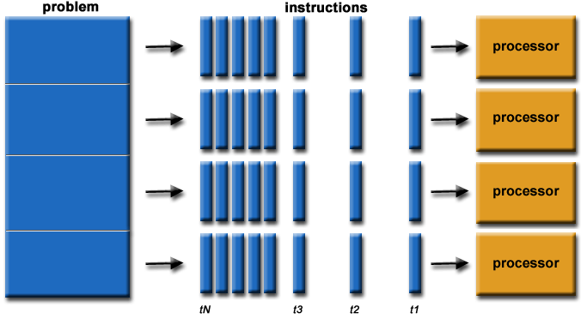
Introduction
1.Parallel processing: A mode of operation in which a process is split into parts, which are executed simultaneously on different processors attached to the same computer.

Slide 3
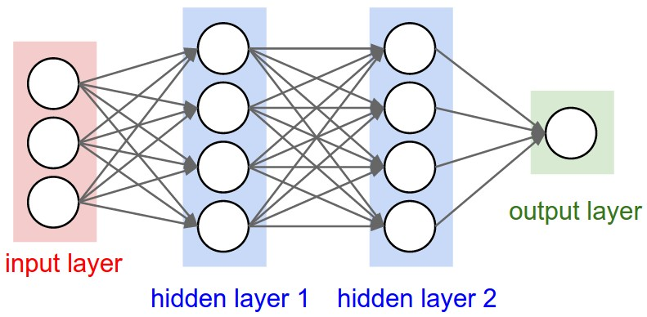
Example: CNN (Convolutional Neural Networks)

Slide 4


Slide 5
Thank you

